Slide 1
Universidade Federal de Alagoas
Instituto de computação
Programa de Pós-Graduação em Informática - PPGI
Expanding code smell detection: assessing interpretability of decision tree-based detections
Master Student: Christiano Rossini Martins Costa
Advisor: Baldoino Fonseca dos Santos Neto

Slide 2
Contents
Introduction
General and specific objectives
Study design
Proposal relevance

Slide 3
Introduction: code smells
Indicates design problem
Leads to design degradation
Violates Known principles
Cohesion
Abstraction
Separation of concerns
More than 20 types

Slide 4
Introduction: automatic detection of C.S.
Sofware Analysis Tools
Highlight anomalies
Increasing awareness
Drawback: low agrements between tools
Rule based
Different thresholds
Machine learning
Have been studied over last years
*learn from object-oriented metrics to make detection

Slide 5
Introduction: ML & Interpretability
Compliance
Fairness and non-discrimination
Transparency
General Data Protection Regulation (GDPR)
Gender or race
Awareness
Explanation
Auditability
Accountability

Slide 6
Introduction: our contribution
Broader study in code smell detection through ML
Previous research: aimed at performance metrics
We propose interpretability
Practical advantages
wider comprehension of detections
* developer is responsible by his code, thus its improvements
* autonomy to make improvements on code
* minimize code check process (e. g. pull requests)
developer might make a proper decision

Slide 7
Motivation
wider comprehension of using decision tree to make code smell detections: is it really interpretable?
Improving autonomy to make improvements on code
Interpretable detection
could guide developer how to fix smelly code
might give insights to debug code
developer might make a proper decision about smelly codes

Slide 8
General and Specific Objectives
General objective
Assess interpretability of decision tree models regarding to code smells detections.
Specific objectives
Evaluate how interpretable are decision tree techinique for code smell detection;
Check developer’s confidence regarding to generated models that detects code smells;
Check the relationship between effectivity of code smell detections and interpretability.

Slide 9
Study Design
Research questions
Study context
Study procedure

Slide 10
Study design
RQ1: How interpretable are machine learning techniques on detecting code smell?
Test perception of developer through visualization
RQ2: How confident is the developer to apply the suggested detections to his context?
RQ3:What’s the relationship between effectivity and interpretability?
how effectivity and interpretability are correlated

Slide 11
Study context
Choosing code smells type
Choosing softwares to extract metrics
Choosing software metrics
Choosing subjects
Building the datasets
Training and building the model

Slide 12
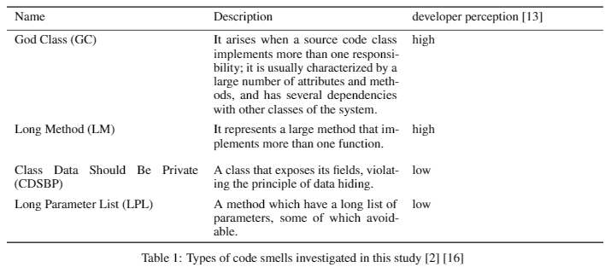
Study Context- choosing code smells types
based on perception of developer
how easy the developer are able to recognize different smell types?
number of Ocurrences in previous researches about code smell detection

Slide 13
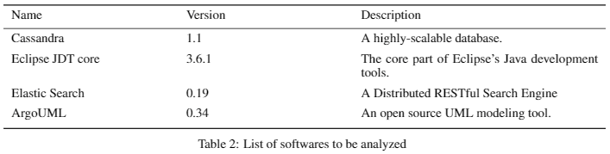
Study context - softwares
Dataset of manually validated code smells, mined from 30 open source systems.
we chose 4 of these system to carry out later experiments

Slide 14
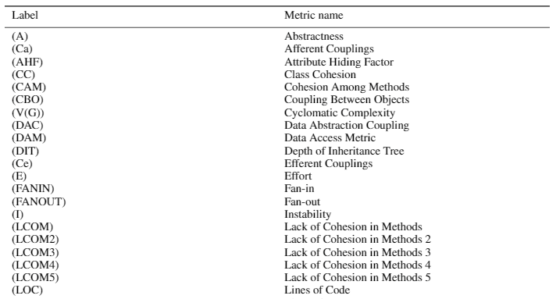
Study context – choosing software metrics
42 metrics relied on overall ocurrence in software engineering literature.
covers aspects of a software product like
size,
complexity,
coupling,
encapsulation,
inheritance and
cohesion
Extraction method
Understand (main)
CKJM
JHawk

Slide 15
Study context – choosing subjects
Number of subjects: 40 up to 50
Category
Academics
Master students
PHD
From industry
Original Developers (not confirmed)

Slide 16
Study context – Building the datasets
Build 4 datasets, 1 for each code smell type
Independet variables: software metrics
Dependent variables: 1 or 0, code smell or not
Step 1 – metrics extraction from classes, software by software
Aided by tool
Step 2 – put together all instances of classes and their metrics of all softwares with respectives code smell types.

Slide 17
Study context – Building the datasets
Ex.: God Class
System 1:
metric1 | metric2 | metric3 | class
God Class Dataset
System 2
metric1 | metric2 | metric3 | class
int | float | int | 0
Int | float | int | 1
int | float | int | 0
merge
metric1 | metric2 | metric3 | class
System 3
metric1 | metric2 | metric3 | class
System N
metric1 | metric2 | metric3 | class

Slide 18
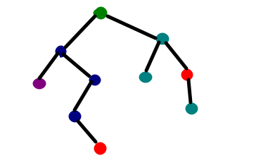
Study context – Training and building the model
Overview
Setup 1
Without feature selection
God Class Dataset
metric1 | metric2 | metric3 | class
int | float | int | 0
Int | float | int | 1
int | float | int | 0
Training
Training
Setup 2
With feature selection

Slide 19
Study context – Training and building the model
Train the datasets with two decision tree setups
Setup 1: C5.0 decision tree
Setup 2: C5.0 decision tree with dimensionality reduction – metrics (feature) selection
Metrics selection with Genetic Algorithms
benefits obtained(Amorim, 2015)
Effectiveness
Higher Precision
Higher Recal
Reduction of size of the tree
Setup 1
Without feature selection
Setup 2
With feature selection

Slide 20
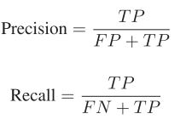
Study context – Training and building the model
Effectiveness Metrics
Precision
Recall
F-measure
Setup 1
Without feature selection
Setup 2
With feature selection

Slide 21
Study Procedure
Build a Web application tool questionnaire in Java or Python
Email invite
Colect data

Slide 22

Study Procedure – colecting data
Overview Part 1
1
2
3
N
Randomize
Subject
Q1: Is it interpretable?​
Q2: What's the code smell the "1s" path is indicating?
1
2
3
N

Slide 23

Study Procedure – colecting data
Overview Part 2
1
Ex.: God Class
God Class indication
Code snippet with God Class code smell
Subject
For you, Is this model matches faithfully to the shown code snippet?

Slide 24
Study Procedure – colecting data
Question's flow
YES
What's the code smell the "1s" path is indicating?
For you, Is this model matches faithfully to the shown code snippet?
Is it interpretable?
what nodes had more relevance for decision making?
NO
Why Not?

Slide 25
Data Analysis
Research Question 1
To what extent are decision tree-based detections comprehensible/interpretable to developer?
Test developer's perception about subjects's comprehensibility / interpretability of detections.
Q1: The decision tree-based code smell detection is compreensible/interpretable to participant?
The percentage of cases models are interpretable.
Q2: What is the main reason that compromises interpretability of decision-tree based detections?
Based on developer's opinion, we will discover how to improve decision-tree based detections to improve interpretability of the models.
Compute these reasons based on text-based mining
Q3: Developer's experience play a role in interpretability?

Slide 26
Data Analysis
Research Question 2
Participants' perception of specific code smell may influence intepretabilit/comprehensibility?
Based on developer's perception of code smell, verify weather of code smell may influence interpretability
Use RQ1 to find compare the percentages of highly perceived and least perceived code smells.

Slide 27
Data Analysis
Research Question 3
How confident is the developer to apply the suggested detections to his context?
Get the percentage of interpretable instances that matches faithfully with code snippet regarding to participant answers.

Slide 28
Data Analysis
Research Question 4
What’s the relationship between effectivity and interpretability?
decision tree trained with more effectiveness (dimensionality reduction ) is more interpretable?

Slide 29
Discussions

